Slide 1
Software Testing
BY : ARVIND SHARMA

Slide 2
Software Testing
Observations about Testing.
Testing is the process of executing a program with
the intention of finding errors.
Testing can show the presence of bugs but never
their absence.

Slide 3
Software Testing
Defect: Variation between actual and expected result known as defect.
Bug: If tester find any mismatch in the application
during testing phase then it is known as a bug.
Error: An error is a mistake, misconception, or misunderstanding on the part of a software developer.

Slide 4
Why testing is important
All software has defect (Bugs).
Software Engineering is not as mature as other
disciplines e.g. Civil Engineering.
Software is written by people – people makes mistakes.
Software testing looks to find the most important
defects as early as possible – increasing confidence
that the software meets the specification.

Slide 5
Who’s involved in testing?
Requirements Analyst – Inspections, Peer Reviews.
Developers – Code Inspection, Unit Testing.
Testers – System and Integration Testing.
Trainers – Training materials production.
Users – User acceptance Testing.
Project Managers – Scheduling, Resourcing, Risks,
Issues, Defect stats.
Everybody is responsible for quality - NASA

Slide 6
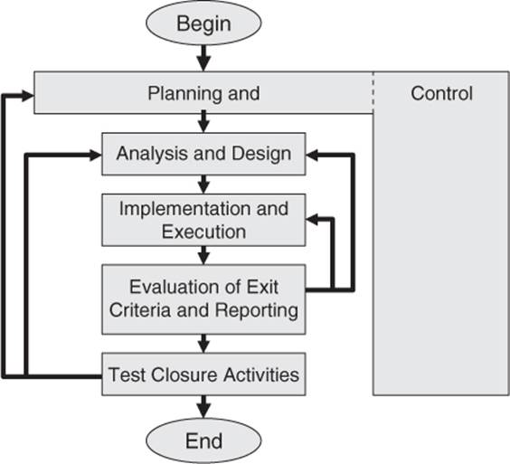
Fundamentals of Software Testing

Slide 7
Principles of Software Testing
There are seven principles of Testing.
Testing shows presence of defects: Software testing
can ensures that defects are present and doesn’t
talk about the absence of defects.
Exhaustive testing is not possible: It is the process
of testing the functionality of a software in all possible
inputs (valid or invalid) and pre-condition is known as
exhaustive testing.

Slide 8
CONT’D
Early testing: To find the defect in the software at initial
phase of the software (Requirement gathering). It can
help to save the money and cost.
Defect clustering: Majority of defects are caused by a
small number of modules. Defect clustering is based on
Pareto principle, where it is stated that 80% of problem
are caused by 20% of the module.

Slide 9
CONT’D
Pesticide paradox: If the same test are repeated over and over again, eventually the same set of test cases
will no longer to find any new defects.
Testing is context dependent: Basically means that
the way you test an e-commerce site will be different
from the way you test a commercial application. You
might use a different approach to test the application.

Slide 10
CONT’D
Absence of error fallacy: It is not only necessary that
software is 99% bug free but it also mandatory to fulfil
all the customer requirements. If a built software is 99%
bug free but it does not follow the user requirement then
it is unusable.

Slide 11
Levels of Testing
Unit Testing
Integration Testing
Validation Testing
Regression Testing
Alpha Testing
Beta Testing
Acceptance Testing

Slide 12
Unit Testing
The most ‘micro’ scale of testing.
Tests done on particular functions or code modules.
Requires knowledge of the internal program design and code.
Done by Programmers (not by testers).

Slide 13
Unit Testing Benefits
Unit testing increases confidence in changing/ maintaining code.
The cost of fixing a defect detected during unit testing is lesser in comparison to that of defects detected at higher levels.
Debugging is easy. When a test fails, only the latest changes need to be debugged.

Slide 14
Why Integration Testing is Necessary
One module can have an adverse effect on another
Sub functions, when combined, may not produce the desired major function
Individually acceptable imprecision in calculations may be magnified to unacceptable levels
Interfacing errors not detected in unit testing may appear
Timing problems (in real-time systems) are not detectable by unit testing
Resource contention problems are not detectable by unit testing

Slide 15
Top-Down Integration
The main control module is used as a driver, and stubs are substituted for all modules directly subordinate to the main module.
Depending on the integration approach selected (depth or breadth first), subordinate stubs are replaced by modules one at a time.
Tests are run as each individual module is integrated.
On the successful completion of a set of tests, another stub is replaced with a real module
Regression testing is performed to ensure that errors have not developed as result of integrating new modules

Slide 16
Problems with Top-Down Integration
Many times, calculations are performed in the modules at the bottom of the hierarchy
Stubs typically do not pass data up to the higher modules
Delaying testing until lower-level modules are ready usually results in integrating many modules at the same time rather than one at a time
Developing stubs that can pass data up is almost as much work as developing the actual module

Slide 17
Bottom-Up Integration
Integration begins with the lowest-level modules, which are combined into clusters, or builds, that perform a specific software sub function
Drivers (control programs developed as stubs) are written to coordinate test case input and output
The cluster is tested
Drivers are removed and clusters are combined moving upward in the program structure

Slide 18
Problems with Bottom-Up Integration
The whole program does not exist until the last module is integrated
Timing and resource contention problems are not found until late in the process

Slide 19
Validation Testing
Determine if the software meets all of the requirements defined in the SRS
Having written requirements is essential
Regression testing is performed to determine if the software still meets all of its requirements in light of changes and modifications to the software
Regression testing involves selectively repeating existing validation tests, not developing new tests

Slide 20
Alpha and Beta Testing
It’s best to provide customers with an outline of the things that you would like them to focus on and specific test scenarios for them to execute.
Provide with customers who are actively involved with a commitment to fix defects that they discover.

Slide 21
Acceptance Testing
Similar to validation testing except that customers are present or directly involved.
Usually the tests are developed by the customer
Acceptance Testing is the fourth and last level of software testing performed after System Testing and before making the system available for actual use.

Slide 22
QA Testing Process for Azure tool
Project Setup - Model Template
Sprint 1 Planning Backlog and Task Creation
Creating User Story
Test Plan Creation and attaching with Current Sprint
Configuration of Test Plan
Test Scenarios Creation /Test Cases creation
Test Cases Execution
Bug Reporting
Test Results

Slide 23
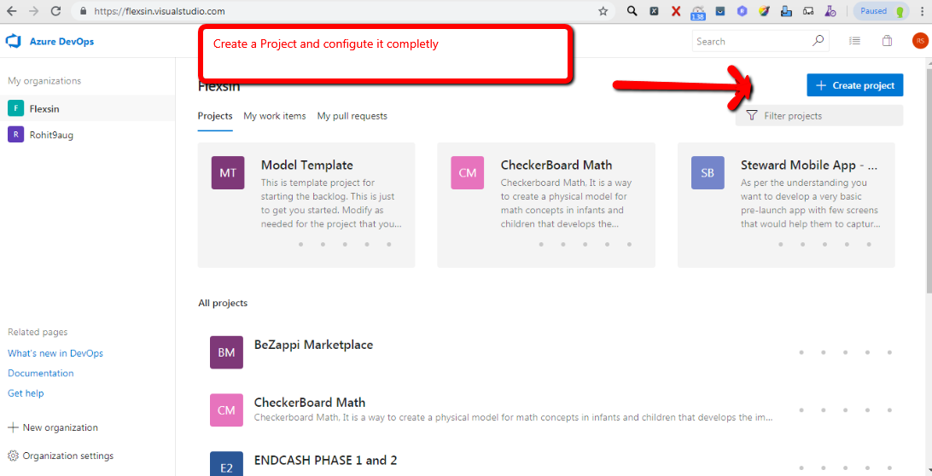
Project Setup-Model Template

Slide 24
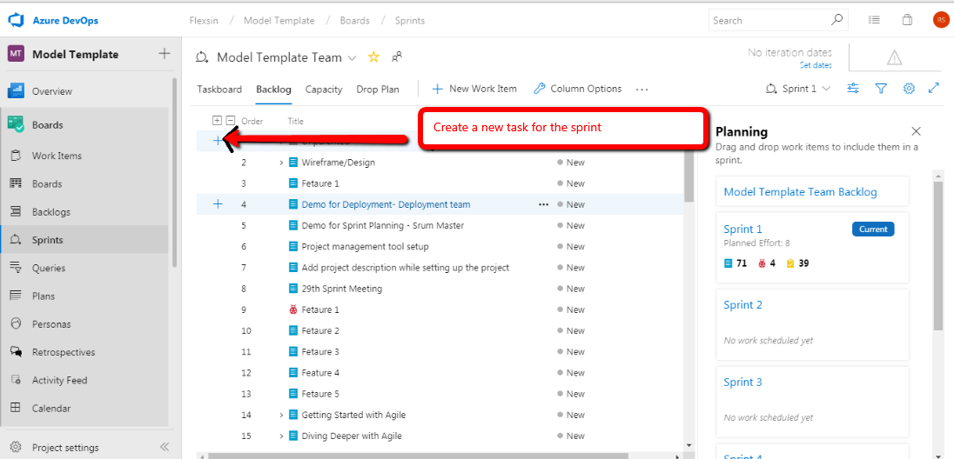
Sprint 1 Planning Backlog and Task Creation

Slide 25
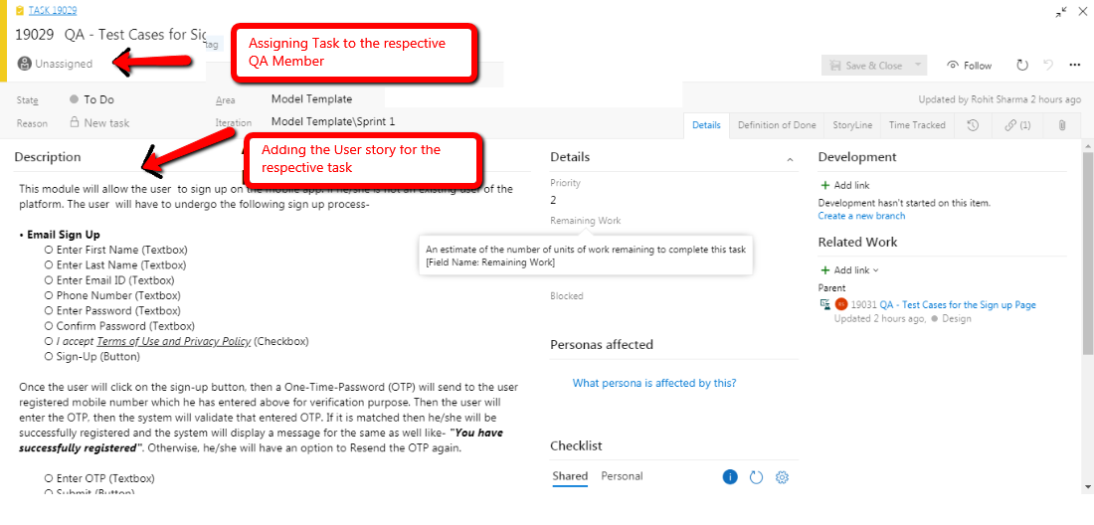
Assigning Task and Creating User Story

Slide 26
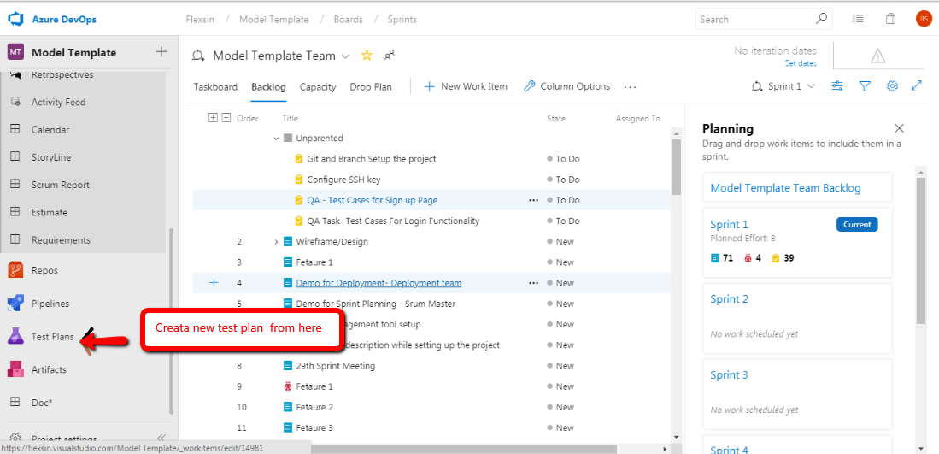
Test Plan Creation and attaching with current sprint

Slide 27
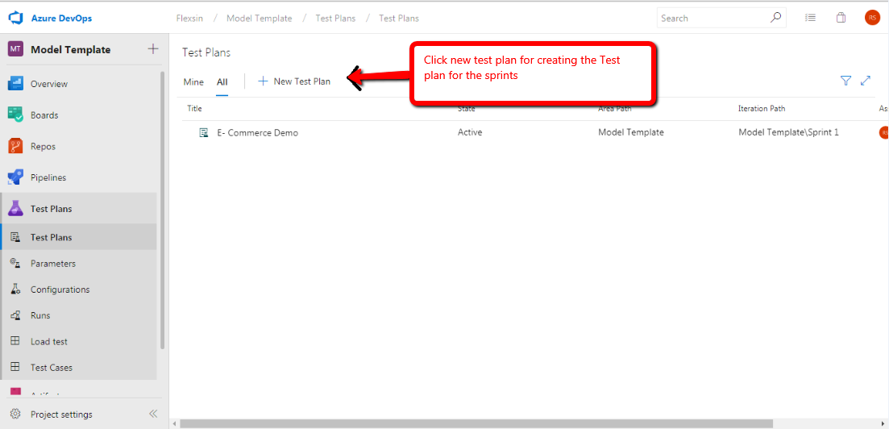
Cont’d

Slide 28
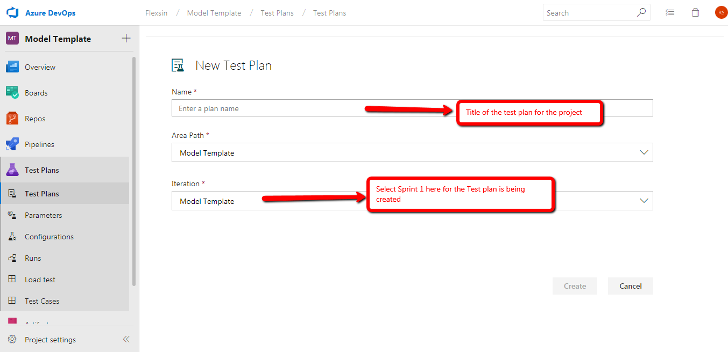
Cont’d

Slide 29
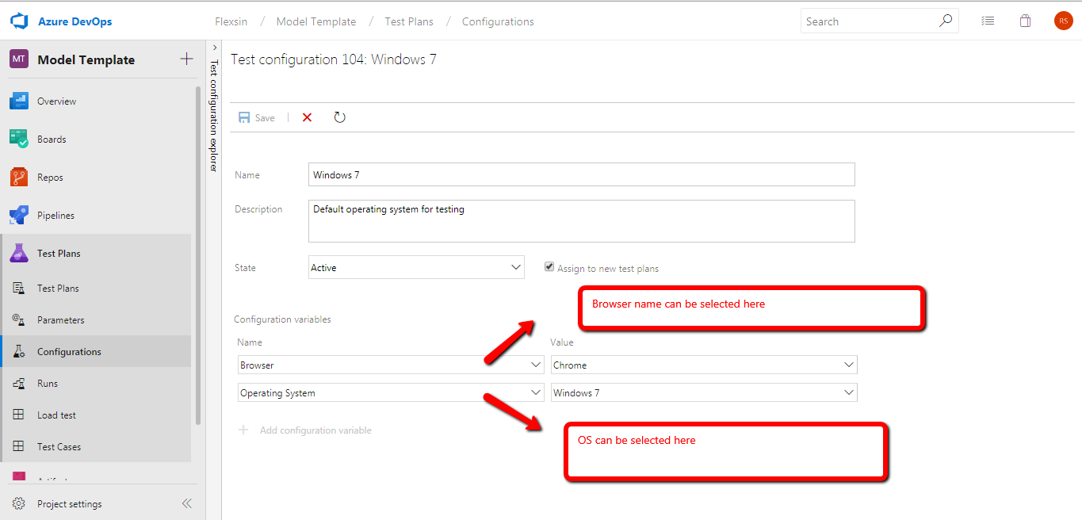
Configuration of Test Plan

Slide 30
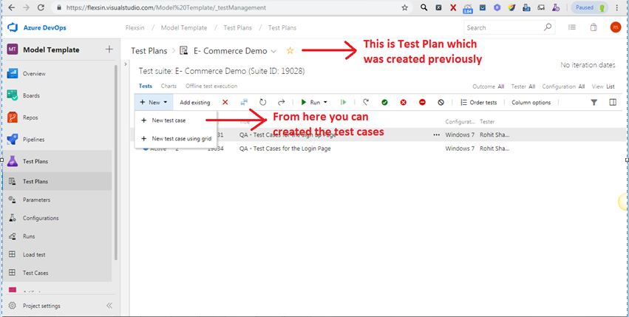
Test Scenarios Creation /Test Cases creation

Slide 31
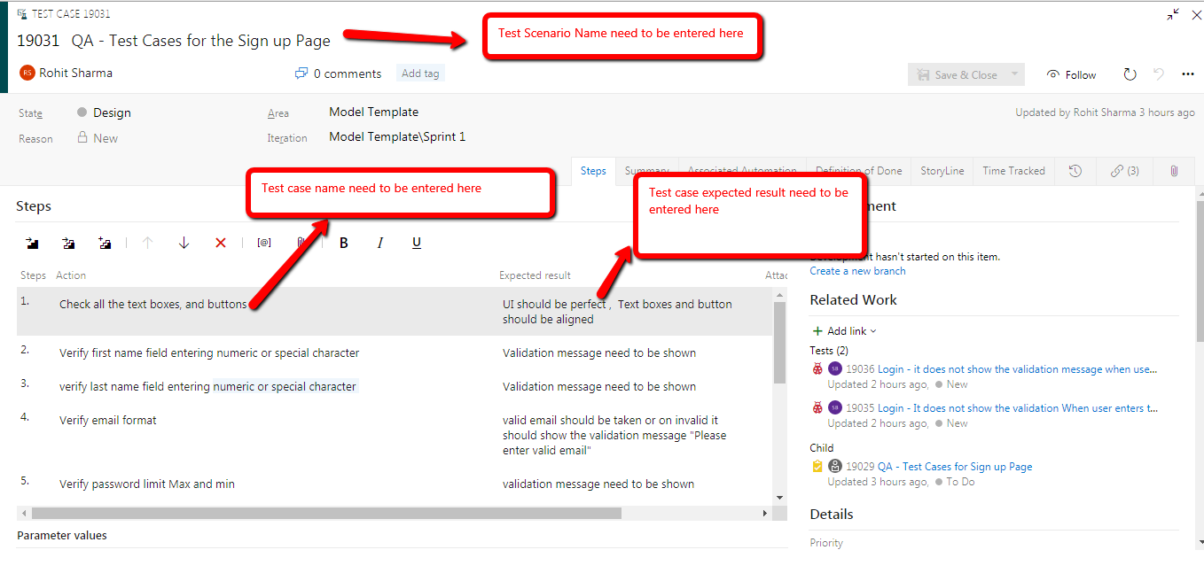
Cont’d

Slide 32
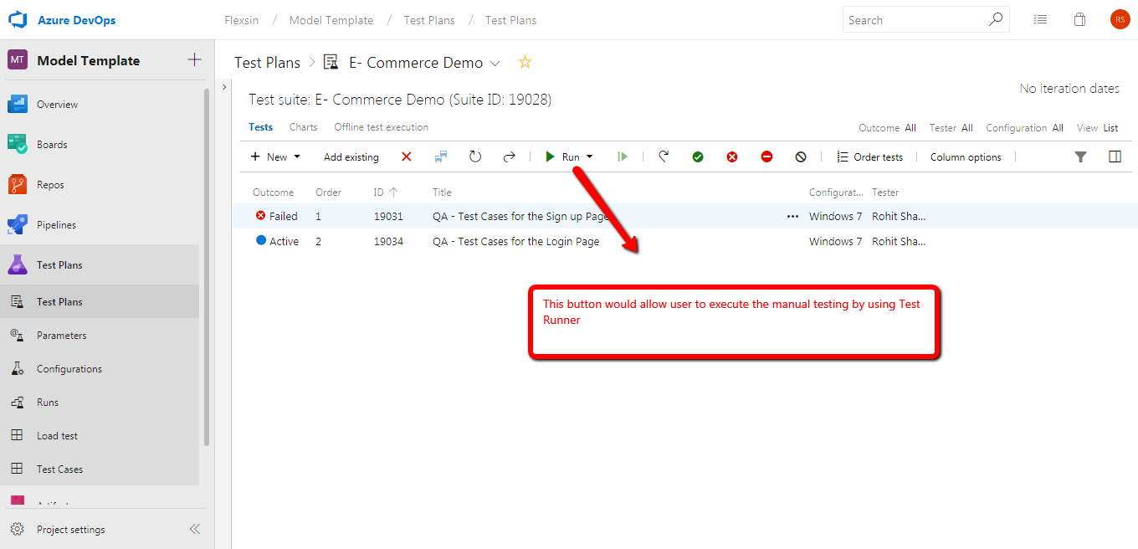
Test Cases Execution

Slide 33
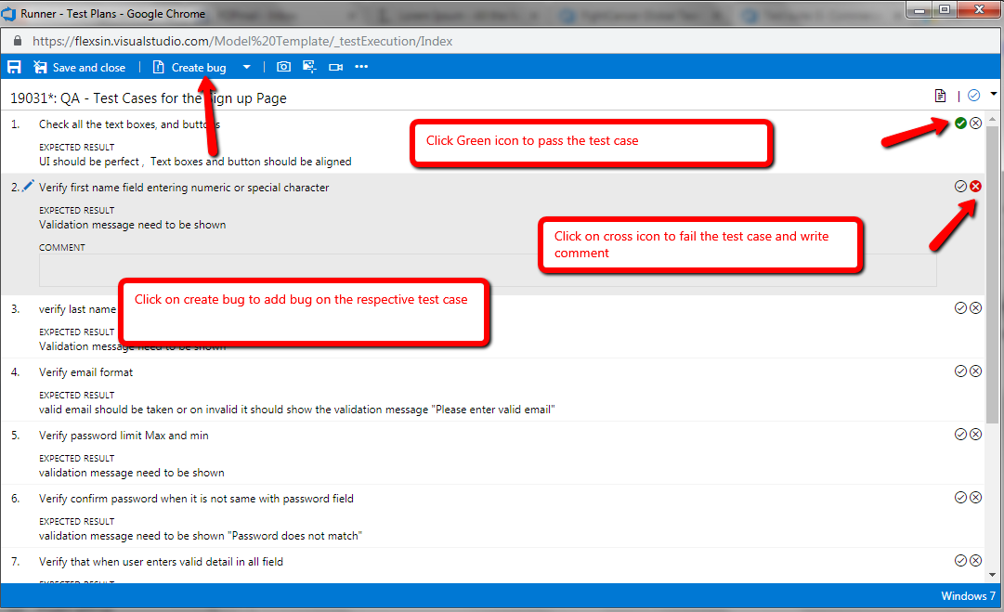
Cont’d

Slide 34
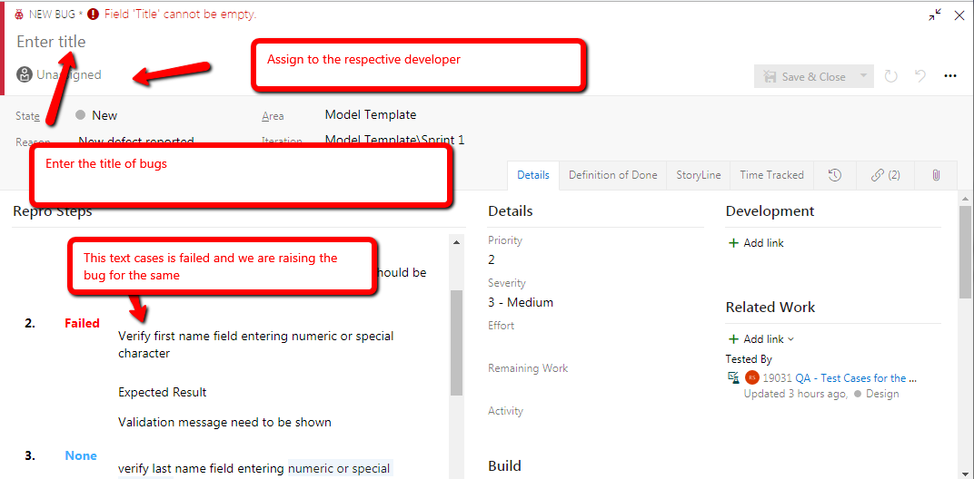
Bug Reporting

Slide 35
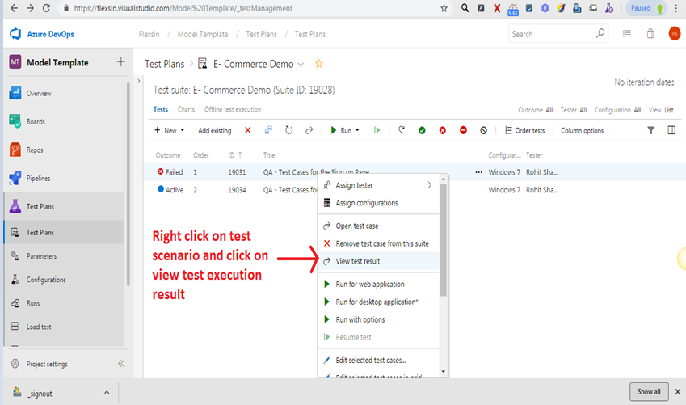
Test Results

Slide 36
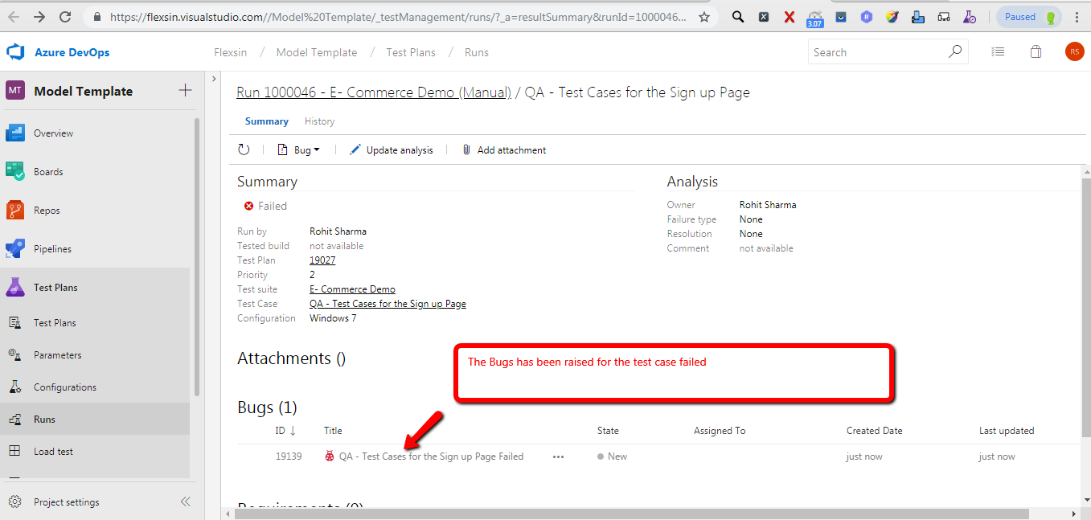
Cont’d

Slide 37
Test Results

